Slide 1
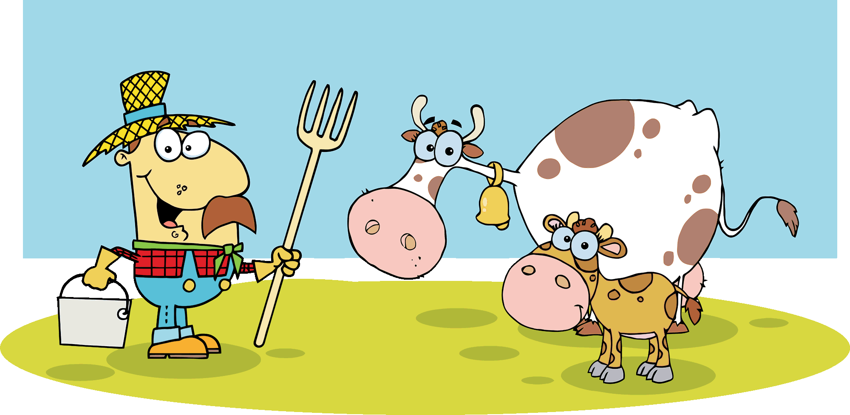
Let’s do phonic sounds
Devised by Coreen Burt www.burtbooks.com
There are matching worksheets in modules 1 and 3 of the Burt Reading Scheme

Slide 2
p
s
t
a
pat
sat
at
tap
sap
pats

Slide 3
n
m
i
d
mid
in
did
dim

Slide 4
s
t
p
i
m
n
d
a

Slide 5
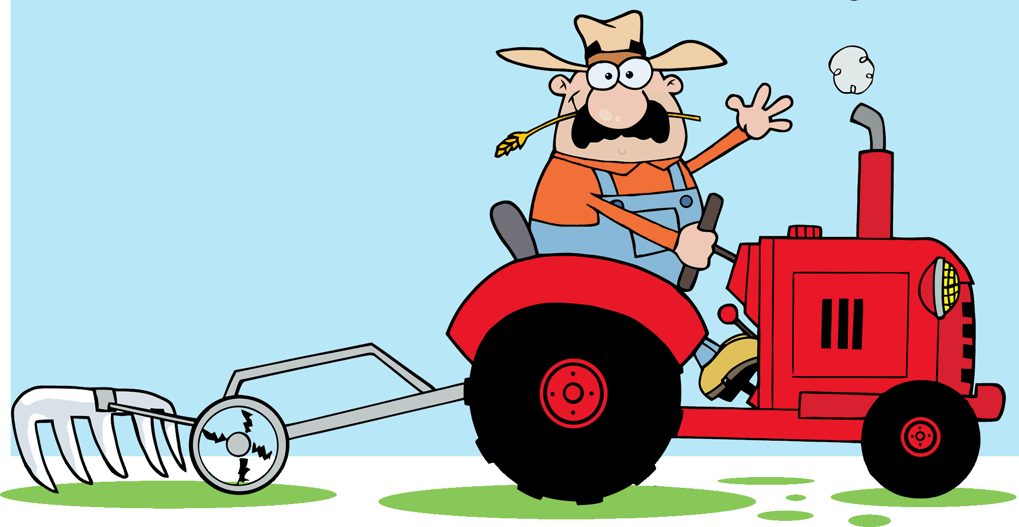
pit
is
sit
tip
it
sat
pip
sip

Slide 6
in
pan
an
nip
tin
pin
nap
tan

Slide 7
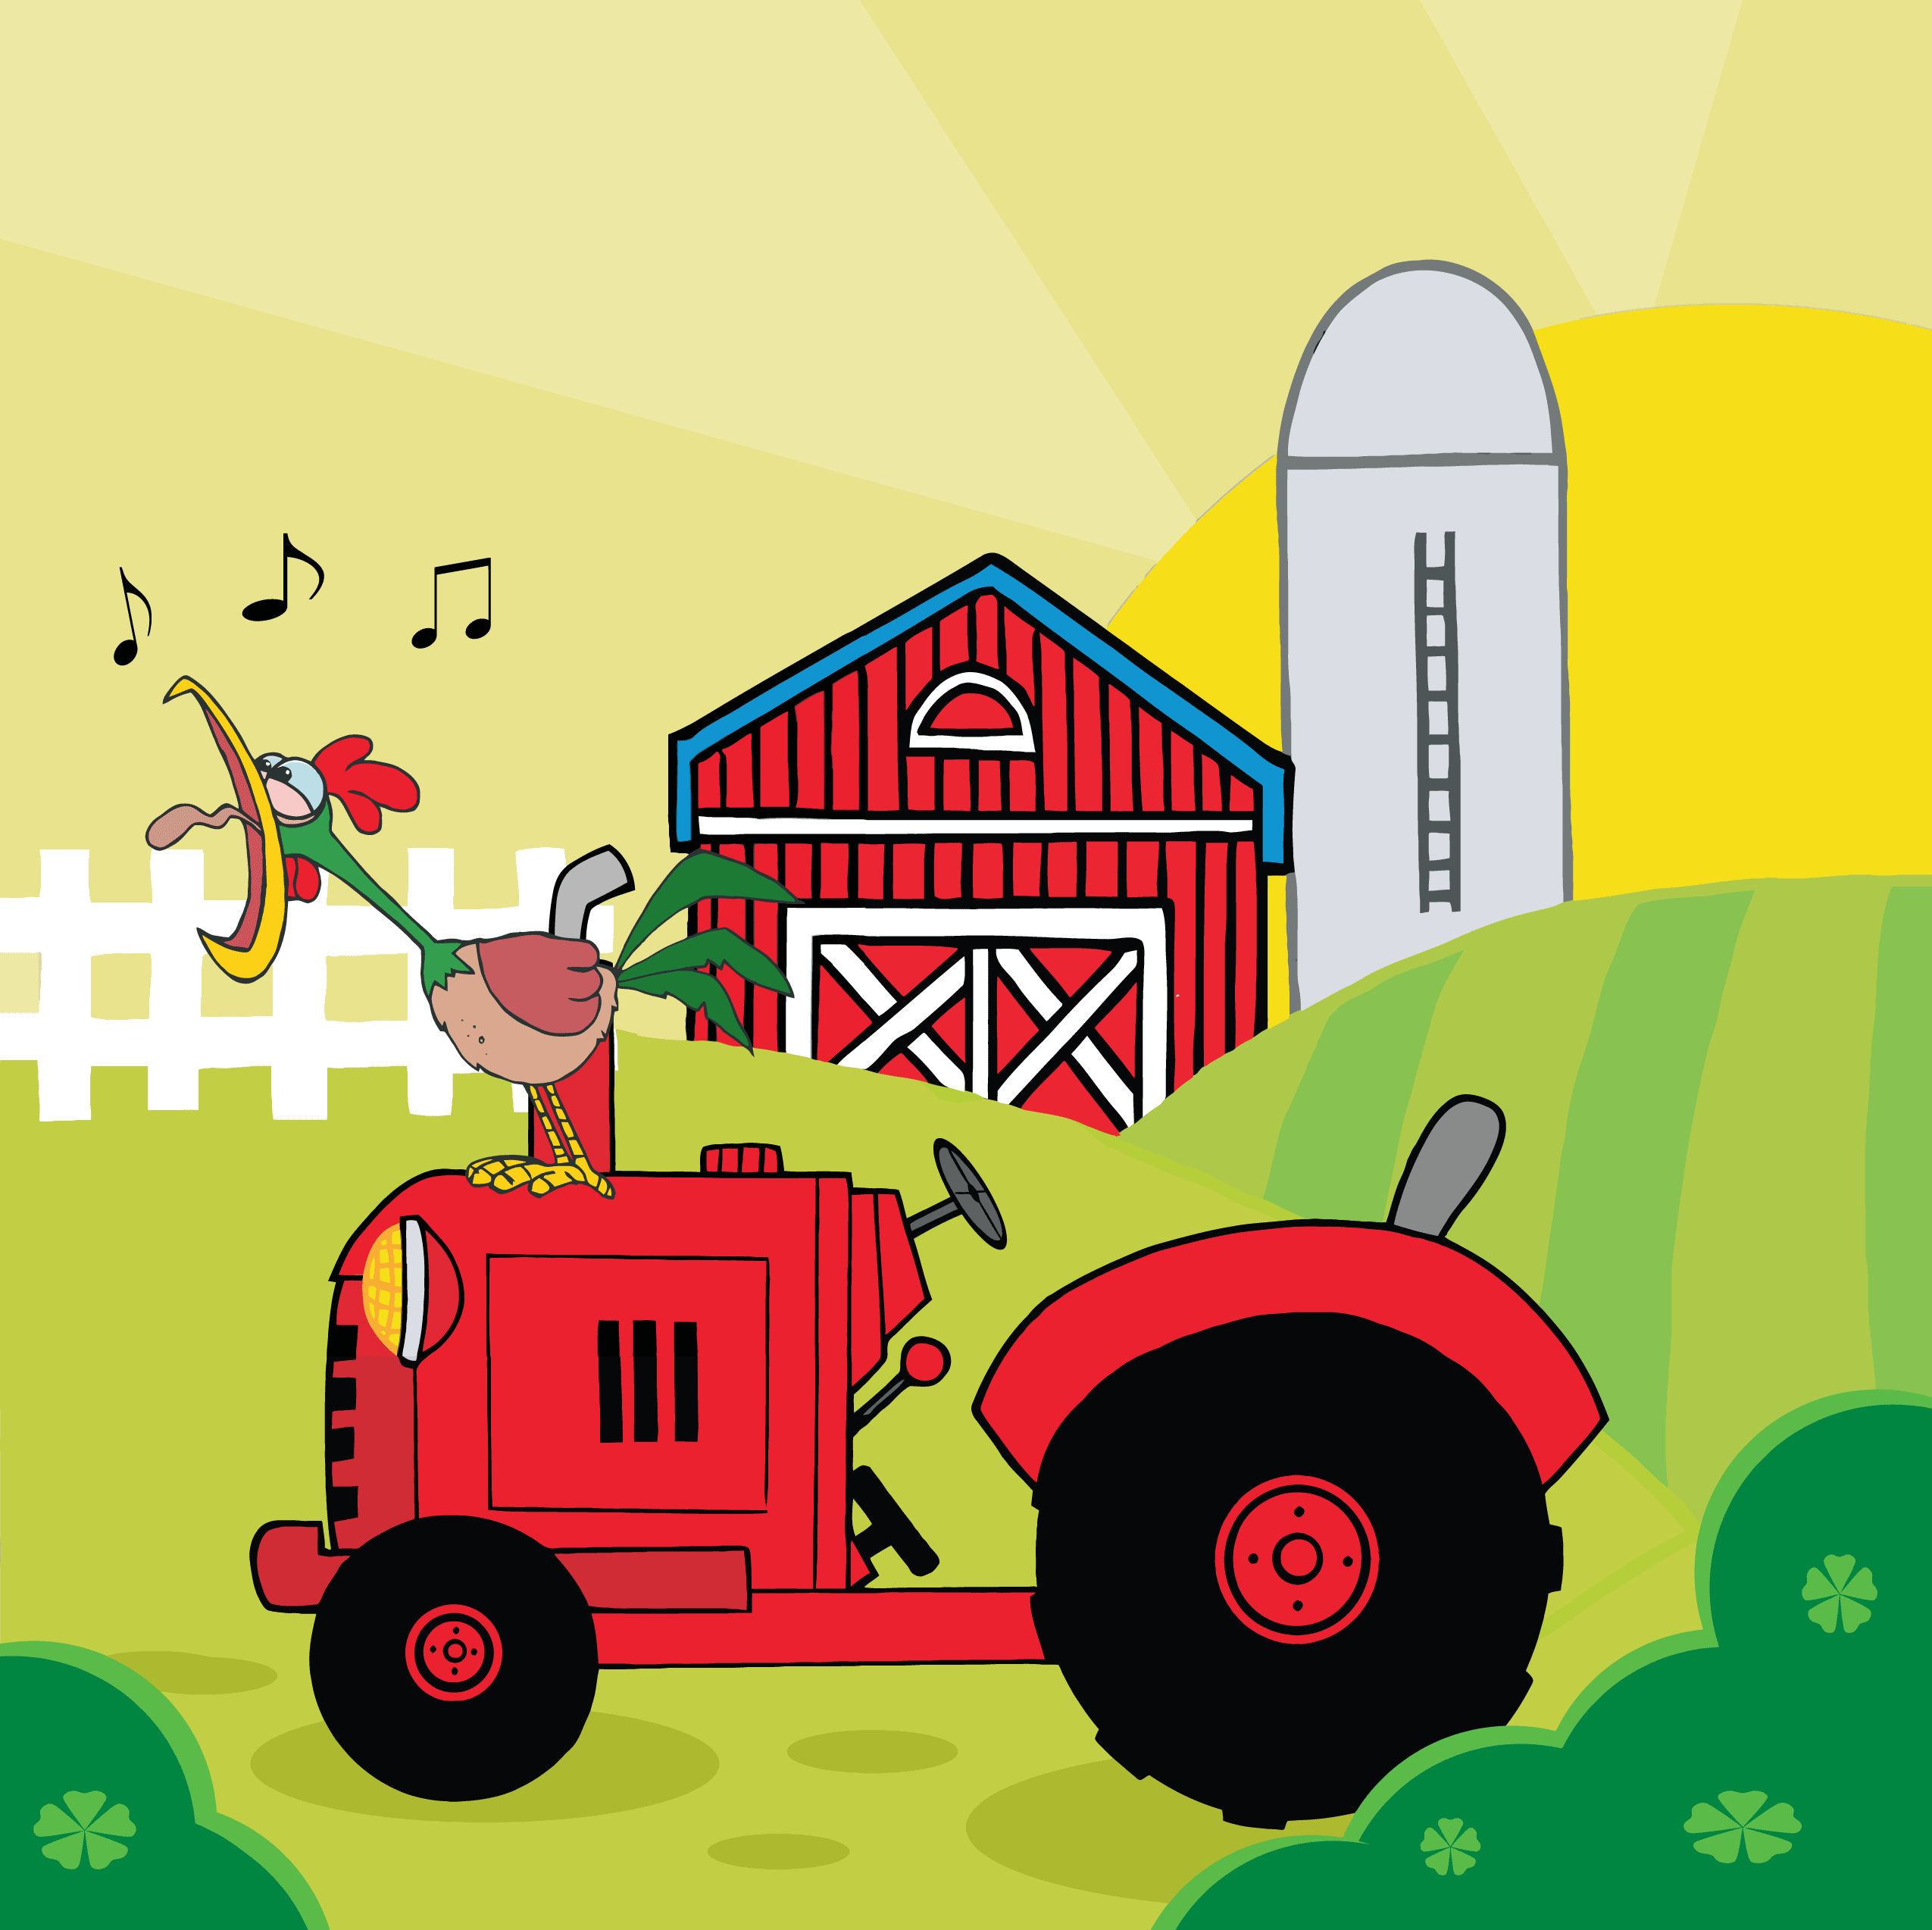
an
in
pin
tin
pan
nip
nap
tan

Slide 8
am
man
mam
mat
map
Tim
Sam
Pam
tan

Slide 9
dip
dim
sad
din
dad
did
and
Sid

