Slide 1
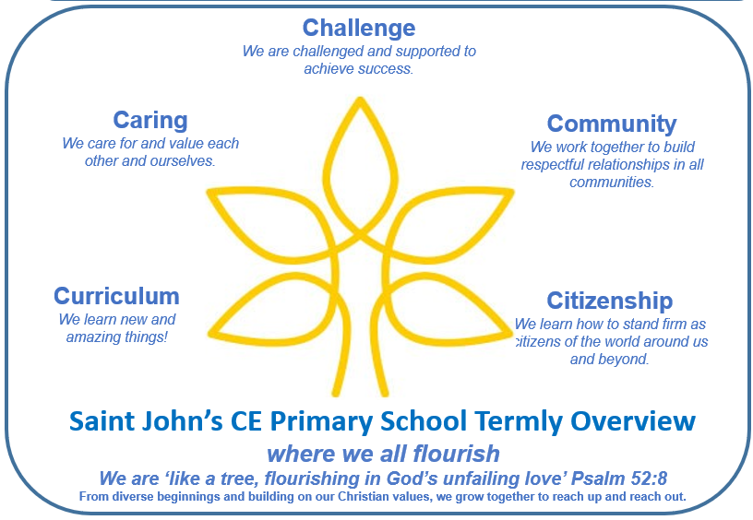
Year 3 - Term 2
Key Question
Which rivers run through our local area and how did they get there?
Key Text
Elf Road
Our class book is ‘The Last Bear’ by Hannah Gold
Key Outcomes
Produce a class book of portal stories
This term’s Christian value: FORGIVENESS
We will consider how we can show this by caring for one another, working together as a supportive community, and showing good citizenship when facing challenges in their learning and play.
Writing and SPAG
In writing we are :
Writing portal stories and focusing on descriptive settings
In grammar we are:
Using expanded noun phrases and prepositions to improve our description
Learning to use rule of 3 sentences
Reading
We are focusing on a range of fiction and non-fiction texts within the themes of:
Predators
Christmas
Our class book is ‘The Last Bear’ by Hannah Gold
Maths
We are learning about
Addition and Subtraction by:
Applying our number bonds to help us use column addition and subtraction
We are learning about Multiplication and Division by:
Using arrays, sharing and grouping to help us become confident with our 2, 5, 10, 3, 4 and 8 times tables
PHSE/RSE
We are:
Working on our listening skills
Learning how to respectfully challenge another person’s view
Exploring different types of family
Exploring different communities
Identifying similarities and differences between a diverse range of people
Learning through Locality
We are exploring which river is closest to Saint John’s and how it affects our local area.
Outdoor Learning
We will be using our outdoor space to observe the water cycle in action.
Home Learning
The children will be asked to read, learn spellings, practise their times tables and complete a maths or writing task each week.
Enrichment and Partnership
Children in Need
Anti-Bullying Week
Open classrooms
Christmas Nativity at Highbury Church
Christmas Service at St Luke’s
Science
We are:
Learning about animals including humans
Identifying that humans and other animals have skeletons and muscles for support, protection and movement
Identifying the right type and amount of nutrition
Geography
We are:
Learning about how the water cycle works and why it’s so important
Exploring which rivers run through our local area and how they form
Learning about the different features of rivers
Exploring the 2007 floods and what has changed in our local area as a result
R.E.
We are thinking about this key question:
How do festivals and family life show what matters to Jewish people?
DT
We are:
Drawing and labelling a simple castle.
Recognising that a castle is made up of multiple 3D shapes.
Designing a castle with key features which satisfy a given purpose.
MFL
We are:
Learning the names of animals you might find in the jungle.
P.E.
We are enjoying:
Netball
Dance

