Slide 1
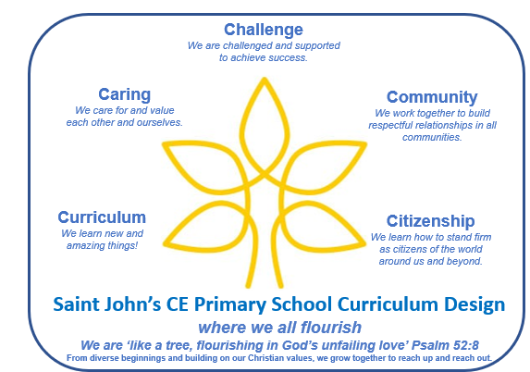
WOW Learning
We are creative and original in our choice of curriculum subjects and themes, ensuring that the pupils’ experiences are wide-ranging and exciting. Learning is specific to our pupils’ needs and prioritises diminishing gaps and being ambitious for everyone.
Key Questions
Our learning starts (and ends!) with questions. Children have the chance to discuss what they want to know, they are given an enquiry question and they have a reflection question at the end of each section of learning, to encourage intellectual curiosity.
Key Texts
Our learning focuses around one or more texts, providing direction and support for the curriculum, placing reading central to our curriculum and ensuring children are exposed to a wide variety of high-quality and diverse texts.
Key Outcomes
Our learning has polished final outcomes, sometimes written, sometimes practical, always engaging and always celebrated with an audience, sharing with other classes or a wider school community. These can be a product, a publication, a presentation and/or a performance.
Learning through Locality
We are proud of our location: our school is set in the middle of Cheltenham. We walk to a wealth of cultural and historical sites/events: our curriculum is bespoke to our locality, building from known to unknown.
Vocabulary
Fundamental to children’s learning is introducing them to essential and ambitious vocabulary. This is done through strategic planning, as well as classes making the most of the unexpected opportunities which arise during learning. Oracy skills are developed during lessons, as well as through opportunities such as our Celebrations of Learning, performances and Look Who’s Talking competitions.
Learning, Reflecting on and Living out our Values
Our Christian values are a golden thread, impacting our daily school experience, seen through our engagement with our curriculum and learning and in our community. Our daily collective worship provides a place for learning and reflecting with visitors providing inspiration and information to the school community. Our values also reflect British values, particularly pertinent for a diverse community and a wonderful variety of backgrounds, languages, religions and culture. In addition, we focus on the three Rs:
Ready, Respectful and Responsible.
Outdoor Learning
We have three playground areas and a messy play area, plus an outside classroom, as well as weekly visits to the College’s enormous Forest School, meaning that we can learn and reflect in different ways and be outdoors!
Knowledge and Skills
Learning will focus on the knowledge and skills of each subject specialism whilst also drawing in cross-curricular themes. Sequenced and progressive planning is based on the EYFS curriculum in Reception moving to the National Curriculum from Year 1 - 6.
Home Learning
The home is key to pupils’ learning so we connect our school learning to home through homework, pupils taking learning home, projects produced at home, parents coming into school and sharing learning through the website.
Recap and Review
All learning is structured so that prior learning (what children already know and understand) is recapped, reviewed and built upon, with sequence and progression key to the learning. Our flashback ZIG-ZAG prompts questions: what did we learn last lesson, last term, last year?
Enrichment and Partnership
There are many extensions to our “regular” learning: trips/visitors, immersive drama experiences, clubs, volunteers and close partnerships with Friends of Sandford Park and Cheltenham College.

Slide 2

TO PLAY AROUND WITH
Challenge
We are challenged and supported to achieve success.
Caring
We care for and value each other and ourselves.
Community
We work together to build respectful relationships in all communities.
Curriculum
We learn new and amazing things!
Citizenship
We learn how to stand firm as citizens of the world around us and beyond.
Saint John’s CE Primary School Curriculum Design
where we all flourish
We are ‘like a tree, flourishing in God’s unfailing love’ Psalm 52:8
From diverse beginnings and building on our Christian values, we grow together to reach up and reach out.

Slide 3
Challenge
We are challenged and supported to achieve success.
Caring
We care for and value each other and ourselves.
Community
We work together to build respectful relationships in all communities.
Curriculum
We learn new and amazing things!
Citizenship
We learn how to stand firm as citizens of the world around us and beyond.
Saint John’s CE Primary School Curriculum Design
where we all flourish
We are ‘like a tree, flourishing in God’s unfailing love’ Psalm 52:8
From diverse beginnings and building on our Christian values, we grow together to reach up and reach out.

