Slide 1
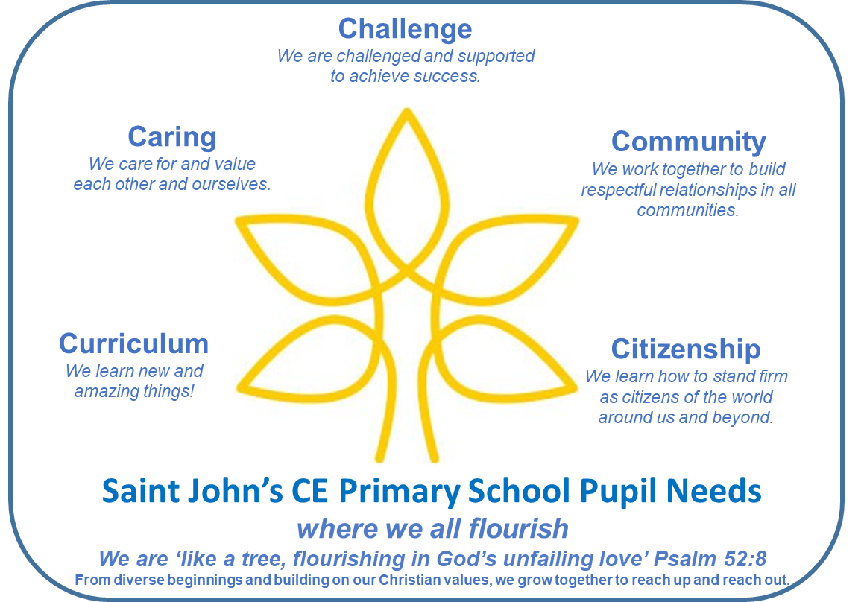
Curriculum Subjects:
Phonics: Floppy Phonics
Reading: bespoke
Writing: T4Writing & Write Journey
Maths: White Rose,
Science: Kapow
Computing:
History: bespoke
Geography: bespoke
Religious Education: Glos Diocese
Art: Kapow
Design Technology: Kapow
Music: Charanga
French: Language Angels
PHSE: Scarf
PE: Get Set 4 PE
Communication
Oracy
Speech & Language
Performances & Presentations
Debate & Persuasion
Literacy & Language
Behaviour as communication
Zones of Regulation
Restorative Conversations
Community and Belonging
Our families
Our churches: St Luke’s & Highbury Congregational
Partnering with College & other schools
Visits to the Wilson Museum, Playhouse/Everyman Theatre
Dementia project
FOSP and Fairview projects
Physical and Mental Health
Playtime
Active Time
PE & swimming (x5 times!)
Outdoor learning
Balancability & Bikeability
Team Sports & Competitions
Fine and gross motor skills
Reflective Practices in the classroom
Pastoral Care in the Nest
Young Minds Matters
Play Therapy & Mentoring
Restorative Practice
Family Support & Engagement
External Agencies & Local Support
The NEEDS of our PUPILS
Personal Development
Christian & British Values, 3Rs: Ready, Respectful and Responsible
Positive and restorative relationships, Circle time, PHSE & SMSC
RE, Spirituality & Worship: invitational, inspirational and inclusive Time in the Nest, Buddy Bench, Drama & Playground Helpers, Worship Committee, School Council, PE Leaders
Challenge and support: Inclusion
Equality and Equity
Citizenship and Diversity
Special Educational Needs
English as an Additional Language
More Able
Neuro-diversity
Gender
Pupil Premium & Free School Meals
Spaces and Places
Playground
Forest school
Reception & Year 1 Outside Area
Front Garden for Growing & Nature
Outdoor Classroom
Library
The Nest
Caring for the Earth/World: solar panels & SIAMS project
Next Steps
Transitions
Local Secondary Schools: Pittville, Bournside, All Saints Balcarras
Grammar and Independent Schools
Further education
Speaking to students about education
Careers and Jobs
Money matters
Cultural Capital
School community
Local visits to parks & open spaces
Trips to museums, theatre & cinema
Experiencing walks in countryside
Residential in Year 6
Extra-curricular clubs and activities
Exposure to variety of visitors
Understanding cultural references

