Slide 1
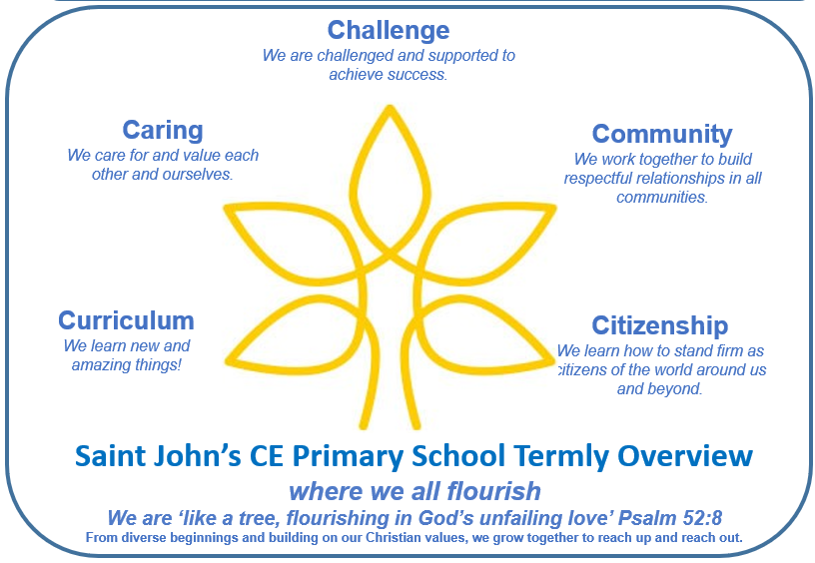
Year 2 Term 6
Key Questions
How is Cheltenham different to Alice Springs?
What conditions do seeds and plants need to grow?
Key Texts
Year 2 Spine books
The Giraffe and the Pelly and Me
Key Outcomes
Persuasive leaflets
Purses created in DT using a running stitch
This term’s Christian value: British Values
We will identify British Values and understand how they are closely linked to Christian Values at Saint John’s. We will explore how various British Values including tolerance, democracy and mutual respect are upheld within our school community.
Writing and SPAG
We will continue to use the Talk for Writing approach this term and our focus will be a non-fiction one. All of our writing, including spelling and punctuation, will be based around our modelled text ‘A new Pirate Theme Park in Cheltenham.’ The children will get the opportunity to write their own persuasive leaflets. We will also read and write some pirate themed poetry, as well have opportunities for some cross- curricular writing.
Reading
Children will continue to have lots of opportunity to read at school. Identifying new vocabulary and its meaning will continue to be a focus, as well as using VIPERS to answer a range of questions. We will also focus on improving our fluency when reading.
We will continue to read our Year 2 ‘Spine Books,’ as well as enjoy our class novel: The Giraffe and the Pelly and Me.
Maths
We will cover two units this term. The first unit is Statistics and the children will learn how to draw and interpret block diagrams and pictograms. The second unit covers Position and Direction and the children will learn how to describe movement and turns using the associated vocabulary.
PHSE/RSE
This term we will be thinking about Growing and Changing. This will include thinking about how the children have changed since they started school. They will also consider which parts of their bodies are private and name them. We will discuss the importance of respecting each others privacy and how some secrets should never be kept.
Learning through Locality
We will be identifying human and physical features in the area we live – Cheltenham.
Outdoor Learning
We will use our front garden to support our science unit exploring the growth of plants.
Home Learning
Weekly spelling tests, with an emphasis of putting words into full sentences.
TT Rock Stars to practise times tables.
Enrichment and Partnership
Open Classrooms and Talk with the Police
R.E. Day
Sports Day
KS2 Performance
Leavers’ service at St Luke’s Church
Weekly reading sessions with students from Cheltenham College.
Science
This term, we are learning about Making Connections: Plant Based Materials. In this topic we will be consolidating knowledge of materials and plant growth through enquiry. We will explore recycling options, identifying natural and man-made materials and experimenting to decide on a suitable material for a plant pot.
Geography
Our unit of work will be based around Cheltenham and how it compares to a Non-European town and our big question being, ‘How is Cheltenham different to Alice Springs in Australia?’ We will compare the two towns by looking at the human and physical features of both. We will develop our fieldwork skills by drawing simple maps using a key.
R.E.
Our question this term is, ‘How can someone’s worldview be seen in the choices they make?’ The children will explore the idea of worldviews and learn about the different things that are important to people. They will think about how our families, experiences and beliefs can influence our choices, values and the way we see the world.
D.T.
This term our unit is called Making a Purse. Children will learn how do to do a running stitch. After looking at a selection of simple purses/pouches, they will design their own using a template. As well as making a purse, children will be able to decorate it. They will evaluate their finished product.
Spelling
Our spellings will be based on our spelling homework. We will identify the rules for the spelling that week and any exceptions that don’t follow the rules. We will also practise writing the words in a variety of sentences.
Computing
This term the children will be learning about Pictograms . Children will begin to understand what data means and how this can be collected in the form of a tally chart. They will then progress onto presenting data in the form of pictograms and finally block diagrams.
P.E.
We will cover two units of work: Team Building, where children will learn about the importance of communication and cooperation, and Striking and Fielding where they will develop their skills through a range of games and activities.
Music
In our unit, Musical Me - Pitch we will be exploring the song ‘Once a Man Fell in a Well’, playing it using tuned percussion and reading simple symbols representing pitch.

