Slide 1
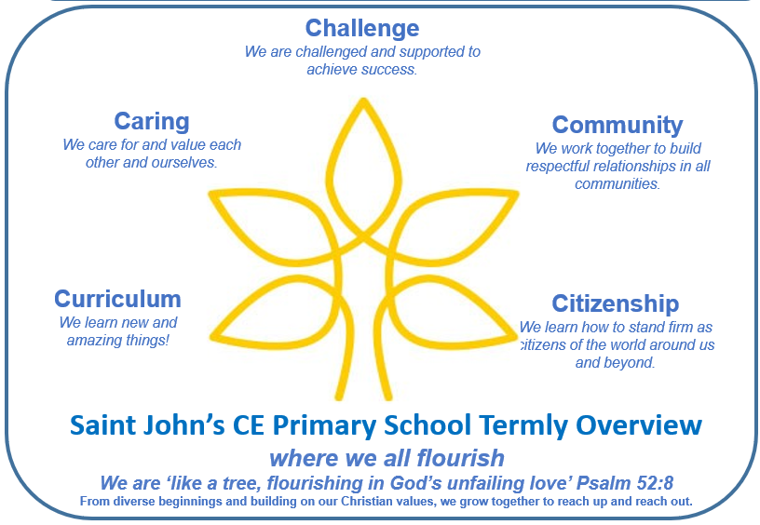
Year 3 - Term 1
Key Question
Would you rather have lived in the Stone Age or the Iron Age?
Key Text
‘How to Wash a Woolly Mammoth’ by Michelle Robinson & Kate Hindley
Our class book is ‘The Stolen Spear’ by Saviour Pirotta
Key Outcome
Write their own set of instructions for washing an animal of their choice
Produce an information leaflet titled about the Stone Age
This term’s Christian values: The 3R’s: Ready, Respectful and Responsible and Patience.
We will consider what the 3R’s look like and come up with examples. We will reflect upon what it looks like to be part of a team and think of examples of how we have shown this value. We will work hard to try and show these values in our every day lives.
Writing and SPAG
In writing we are :
Writing instructions based on the book ‘How to wash a woolly mammoth’
Writing a warning tale
In grammar we are:
Using organisational features in non-narrative writing
Using imperative verbs when writing instructions
Learning to use fronted adverbials in our writing
Reading
We are focusing on a range of fiction and non-fiction texts within the themes of:
Climate Change
The Stone Age
The Iron Age
We will use reading VIPERS to develop our comprehension skills
Our class book is ‘The Stolen Spear’ by Saviour Pirotta
Maths
We are learning about Place Value by:
Representing numbers and partitioning them
Placing numbers on a number line to order and compare them
We are learning about Addition and Subtraction by:
Applying our number bonds to help us use column addition and subtraction
PHSE/RSE
We are:
Creating classroom expectations to ensure our classroom is a safe and happy place
Exploring how to create positive relationships and how to resolve conflict
Learning to express our opinions and listen to the opinions of others
Learning through Locality
We are exploring what artefacts from prehistory have been found in Cheltenham
Outdoor Learning
We will be using our outdoor space to gather natural materials to make homemade paints
Home Learning
The children will be asked to spend time on TTRockstars, read, learn spellings and complete a maths or writing task each week
Enrichment and Partnership
Cheltenham Literature Festival
Celebration of Learning at Highbury
Open classrooms
Weekly reading sessions with volunteers
Science
We are:
Learning about how animals move
Looking at nutrition and how animals can stay healthy
History
We are:
Exploring ‘prehistory’ and making deductions about the past by examining artefacts
Understanding how humans survived the Stone Age
Thinking about why the introduction of bronze was a significant change in history
Exploring what life was like in an Iron Age hillfort
R.E.
We are thinking about this question:
What might Christians learn from the Creation narrative?
Art
We are:
Discovering how and why our ancient ancestors made art, experimenting with natural materials to make homemade paints and playing with scale to paint on a range of surfaces
MFL
We are:
Learning how to say hello and introduce ourselves
Learning to say how we are feeling
Learn colours and numbers
Computing
We are:
Developing our understanding of digital devices by exploring inputs, processes and outputs
Learning how computers are connected
P.E.
We are enjoying:
Exploring the fundamental skills of balancing, running, jumping, hopping and skipping
Football

