Slide 1





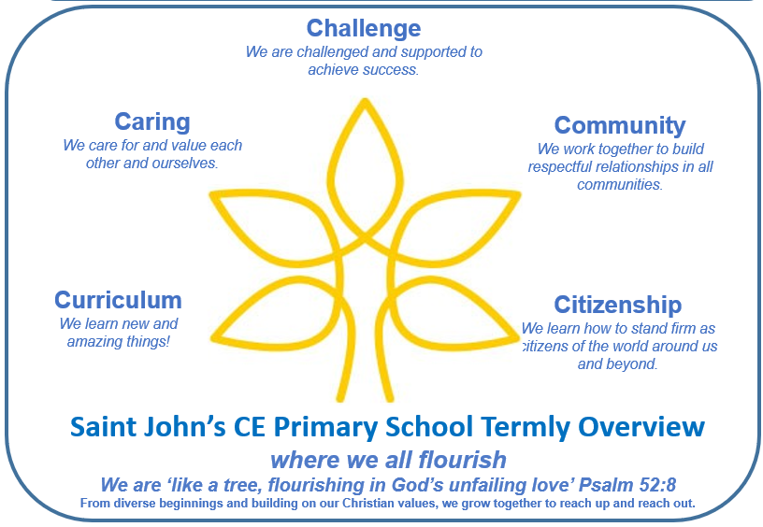
Reception Term 1
Key Questions –
Why am I special?
Key Texts
Key outcomes - Discussing our families, recounting fun family experiences in our past.. Thinking about changes in our life as we grow and get older. Look at our school grounds and the history/changes within our school. Look at how homes have changed over time. Compare own homes to those from the past. Explore, compare and contrast toys past and present. Share favourite toys and listen to parents/grandparent’s childhood experiences of favourite toys.
This term’s Christian value: Ready, Respectful and Responsible and Patience
We will consider how we can show this in our school community, through caring for each other. We will reflect on how we have shown patience in key events, such as starting school.
Personal Social and Emotional Development - PHSE/RSE
SCARF -
Me and my relationships
All about me
What makes me special
Me and my special people
Who can help me?
My feelings
Literacy – Talk4Writing
Fiction – Dear Zoo and We’re going on a bear hunt. Oral recounts, role play and drama, sequencing the story.
Non fiction – How to look after a pet – link to visit from Dog’s trust.
Poetry – Nursery rhymes.
Communication and Language Development –
Speaking/ developing sentence structure .
Exploring Vocabulary.
Learning and reciting, poems and songs.
Discussing families and how we change as we get older.
Literacy – Reading linked to T4W
Bear Hunt, Dear Zoo
Discuss events and setting in a story.
Beginning, middle and end .
Listen to stories, accurately anticipating key events & respond to what they hear with relevant comments, questions and reactions.
Make predictions
Beginning to understand that a non-fiction is a non-story- it gives information instead. Fiction means story. - Can point to front cover, back cover, spine, blurb, illustration, illustrator, author and title.
Sort books into categories.
Maths – White Rose Maths Baseline/Getting to know you to include early cunting, number rhymes.
Compare, match and sort, which will include matching objects, finding rules for sorting and identifying sets with more and fewer.
Talking about measures and patterns, which includes mass, capacity and repeating patterns.
Learning through Locality
Exploring schools’ grounds and observing seasonal changes in the Autumn
Outdoor Learning
Weekly messy play sessions.
Free flow.
Home Learning
Phonic sheets and texts, reading, ordering numbers out of milk bottle tops.
Enrichment and Partnership
Celebration of Learning at Highbury Church
Volunteer support from Cheltenham Ladies College
Open classroom
Understanding the World -Science
Similarities and differences between animals and habitats.
Similarities and differences between children.
How we change as we grow.
Naming body parts.
Understanding the World -History and Geography
Talk about the lives of people around them and their roles in society.
Know some similarities and differences between things in the past and now, drawing on their experiences and what has been read in class .
Understand the past through settings, characters and events encountered in books read in class and storytelling.
R.E. Why is God important?
What is the story many Christians tell about God creating the world, and what does it mean for Christian people?
Why might believing in God make Christians want to care for the world?
`How and why might many Christians say thank you to God?
What do many Christians believe about God’s love?
What have we learnt about why God is so important to Christians and how did we learn it?
Expressive Art and Design -Art/DT
Beginning to mix colours
Build stories around toys (small world) use available props to support role play
Build models using construction equipment.
To draw a self-portrait (enclosing lines): draw definite features.
Music
Charanga –Pat-a-cake
1, 2, 3, 4, 5, Once I Caught a Fish Alive
This Old Man
Five Little Ducks
Name Song
Things For Fingers
Phonics - Phase 1 and begin to introduce 2
Hear general sound discrimination, identify rhythm, rhyme, alliteration and be able to orally blend and segment simple words.
See phonic overview
Baseline Assessment ongoing for 3 weeks.
Physical Development - P.E.
Introduction to PE and Dance
Moving safely and following a path, co-ordination and co-operating with others, working independently, Cooperation games i.e. parachute games. Climbing – outdoor equipment. Help individual children to develop good personal hygiene.. Provide regular reminders about thorough handwashing and toileting.

