Slide 1
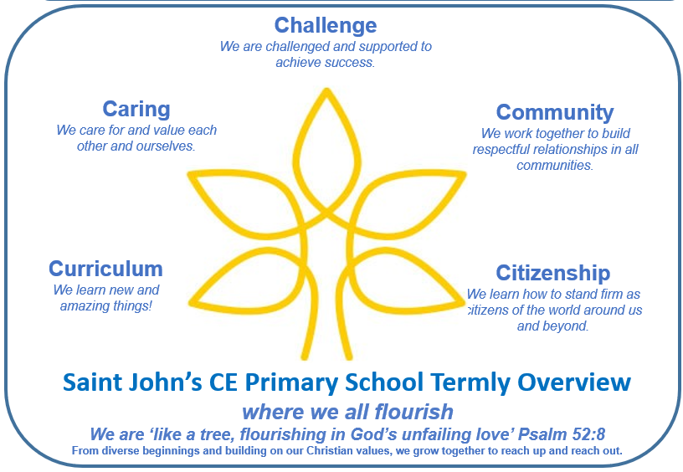
Year 5 Term 1
Key Questions
Why were the Maya top of the class?
Why are some materials suitable for certain purposes while others are not?
Key Texts
Macbeth by Andrew Matthews
The Closest Thing to Flying by Gill Lewis
Key Outcomes
Macbeth narrative
Potion recipe instructions
This term’s Christian value: Ready, Respectful, Responsible and Patience
We will consider how we can show these in our school community, through caring for each other. We will reflect on those who demonstrate these values towards us as well as how we can demonstrate them to others.
PHSE/RSE
We will learn about:
Me and My Relationships
Give and take
How good a friend are you?
Our emotional needs
Being assertive
Writing and SPAG
We will be looking at the Shakespeare story of Macbeth - In this narrative, we will focus on setting and description and we will develop a toolkit that will help us write our own narrative with this in mind.
Following this, we will use our key text to inspire us to write some instructions on how to make a potion.
Reading
We will be looking at a range of materials to develop our reading skills:
Vocabulary
Inference
Prediction
Explanation
Retrieval
Summarise
Maths
We will learn about:
Place Value – using numbers to 1 million, including comparing and rounding
The four operations – addition, subtraction, multiplication and division
Fractions – finding equivalents and using mixed numbers
Learning through Locality and Outdoor Learning
We will be using our outdoor spaces to help us with our science, using different materials to explore mixtures, sieving and filtering.
Home Learning
Over the course of the autumn term, children can research, develop and create a piece of project work of their choosing that demonstrates what they have learnt about any of the areas that we have investigated.
Enrichment and Partnership
Cheltenham Literature Festival
Swimming at Cheltenham College
Celebration of Learning at Highbury Church
Art
We will explore:
Drawing: depth, emotion and movement
Use various types of lines to emphasis movement and emotion
Use a combination of marks to create tone and depth
Consider composition carefully
Science
We will learn about Materials, including mixtures and separation:
Find out about mixtures and name some common examples
Find out about sieving and it this can separate mixtures
Explore filtering and how this can separate mixtures
Define solution and dissolve naming some common examples of solutions.
History
We learn about:
The Ancient Maya– when and who were they
Where the Ancient Maya lived
The Ancient Maya beliefs
Evey day life of the Maya people
What we can learn from them from what they have left behind
R.E.
What influence does believing in God as Trinity have on Christian worldviews?
We will learn:
What the Trinity is
How Christians can find out information about the Trinity
How ideas from the Trinity are expressed through art
How Christians are responding to ideas about the Holy Spirit
Phonics/MFL
We will learn about:
Presenting myself
Basic greetings
Asking somebody their name
Asking somebody their age and where they live
Computing
We will learn about:
Systems and Searching
Safely searching the web
How searches are ranked and influenced
P.E.
We will develop skills in:
Swimming
Fitness

